Slide 1
AMAZON SALES DATA ANALYSIS REPORT
Presented by Yash Singh

Slide 2
Objective
Sale management has grown in importance in response to increased competitiveness and the necessity for efficient distribution strategies to decrease costs and raise revenues. Find the monthly, yearly, and yearly sales and profit trends.

Slide 3
Benefits
Help out to make better business decisions. • Help analyze customer trends and satisfaction, which can lead to new and better products and services. • Gives better insight of customers base. • Helps in easy flow for managing resources.

Slide 4
Problem Statement
Sales management has gained importance to meet increasing competition and the need for improved methods of distribution to reduce cost and to increase profits. Sales management today is the most important function in a commercial and business enterprise.

Slide 5
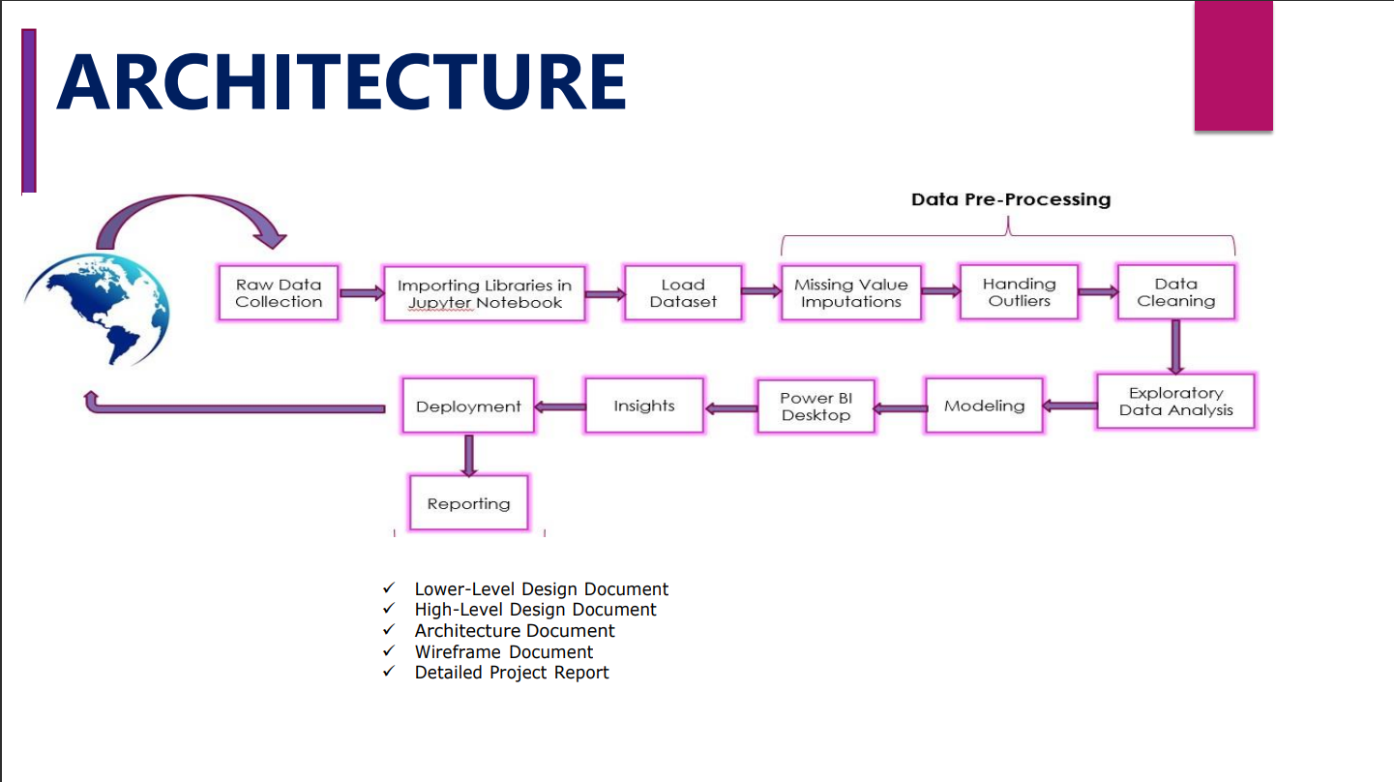

Slide 6
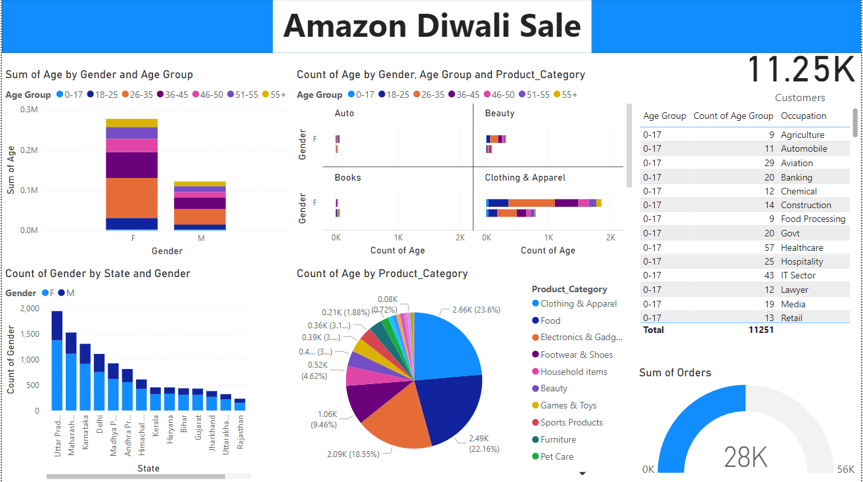
Quick Insight

Slide 7
Conclusion
In conclusion, understanding these insights can help the company tailor its marketing strategies, product offerings, and inventory management to effectively target key demographics and capitalize on emerging trends in consumer behavior during the Diwali sales period.

